Slide 1
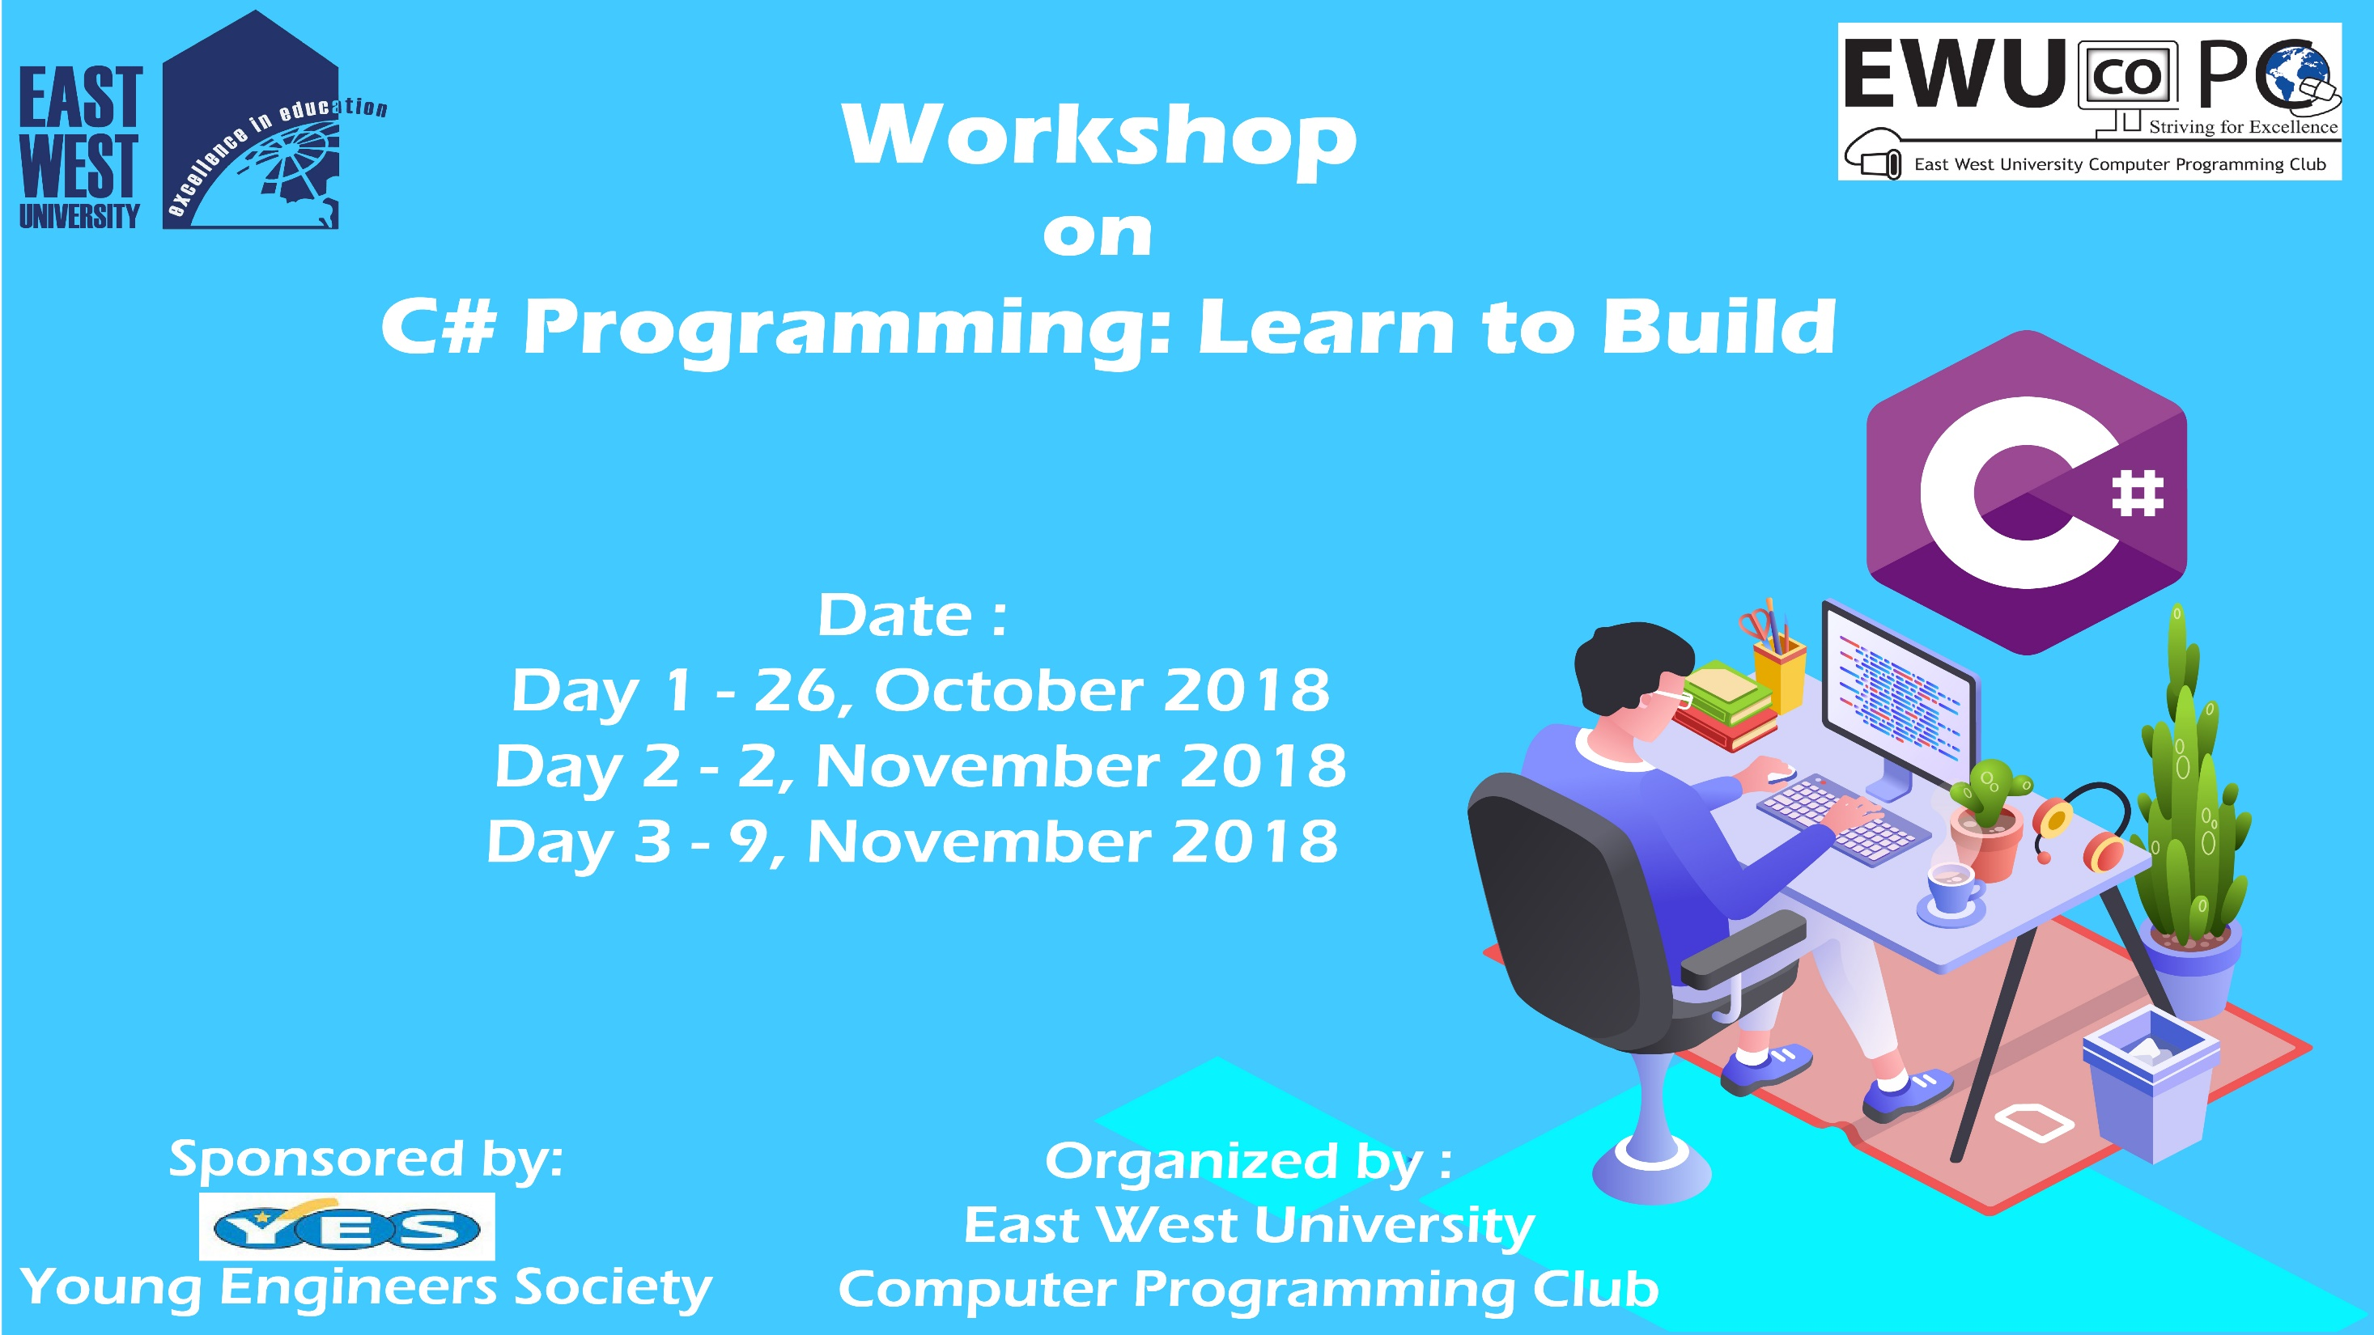

Slide 2
C# Day 2 Lecture9: Array

Slide 3
Array
Multiple data in one Variable
int[] arr1 = new int[5];

Slide 4
Array
int[] arr2 = new int[5] { 0, 1, 3, 4, 5 };

Slide 5
Array
int[] arr3 = new int[] { 1, 2, 3, 4, 5, 6, 7, 8, 9, };

Slide 6
Multidimensional Array
int[,] mular1 = new int[2, 3];

Slide 7
Multidimensional Array
int[,] mular1 = new int[2, 3];
mular1[0, 1] = 10;

Slide 8
Multidimensional Array
int[,] mular2 = new int[,] { { 10, 29 }, { 30, 40 } };

Slide 9
Jagged Array
int[][] array2 = new int[3][];
array2[0] = new int[3] { 1, 2, 3 };
array2[1] = new int[] { 4, 5, 6, 7, 8, 9 };
array2[2] = new int[10];
Console.WriteLine(array2[0][1]);
Console.ReadKey();

Slide 10
This slide is provided as a course material in the workshop named “Workshop on C# Programming: Learn to Build”.
Organized by-
East West University Computer Programming Club (EWUCoPC)
Prepared by- Jannat Binta Alam
Campus Ambassador
Young Engineers Society (YES)
E-mail: jannat.cse.ewu@gmail.com

